Slide 1
PROJECT OF INTRODUCTION OF SOFTWARE
Dr. Israa Ahmed

Slide 2
Members Of Team:
1-Mahmoud Ashrey Mahmoud 4-Norhan Mohamed Yahia
ID: 2302594 ID: 2302281
2-Ebtihal Elsayed Ayoub 5-Fares Mohamed Abdel Fattah
ID: 2302291 ID: 2302536
3-Mohamed Mahmoud Abdel Majeed 6-Fatma Ahmed Hamdy
ID: 2302068 ID: 2302289

Slide 3
Project content:
1- lntroduction Of Project
2- User Scenarios
3- Requirements
4- Methodolog
5- Diagrams

Slide 4
1- Introduction of project
.We’re Glad You’re Here. Today We’re Going To Introduce You To Our Project , Which Is About An Mobile Registeration Materials.
The Online Registration System for Student Materials is designed to streamline the registration process for students. This system allows users to register, log in, view available courses, register for courses, pay fees, and generate reports. It ensures a seamless, secure, and user-friendly experience.

Slide 5
Project content:
1- lntroduction Of Project
2- User Scenarios
3- Requirements
4- Methodolog
5- Diagrams

Slide 6
2- User Scenarios
• In our electronic platform, the user will go through several stages before reaching the stage of actual material registration and acceptance of his registration request, and he has two options: either register the materials smoothly and properly, or fail to register the materials for some reason, so we will divide our scenario into two directions:
1-Happy path
2-Unhappy path

Slide 7
1-Happy path
Happy Path The ideal scenario where all steps execute successfully without errors :
. User accesses the system and registers a new account.
. The system verifies the entered data (e.g., email and password).
. User logs in with valid credentials.
. The system displays a list of available courses.
. User selects desired courses and registers.
. Payment is made using an accepted payment method.
. Registration is confirmed, and a confirmation message is sent.
. User successfully views the registration report.

Slide 8
2-Unhappy path
Unhappy Path Scenarios where errors occur or exceptions are handled :
. Account Registration :
Invalid email entered → An error message prompts the user for a valid email.
. Login:
Incorrect password entered → An error message indicates invalid credentials.
. Course Selection :
Attempt to register for a fully booked course → An error message indicates no available slots.
. Payment:
Invalid payment details entered → An error message prompts for updated payment information.

Slide 9
Project content:
1- lntroduction Of Project
2- User Scenarios
3- Requirements
4- Methodolog
5- Diagrams

Slide 10
3- Requirements
. 1- User and System Requirements
(A) User Requirements
(B) System Requirements

Slide 11
(A) User Requirements
                Users should be able to :
- Register a new account .
- Log in to the system .
- View a list of available courses .
- Register for courses .
- Pay fees using electronic payment methods .
- View registration reports.

Slide 12
(B) System Requirements
- Backend:
Database for storing user data, course information, and registrations.
- Frontend:
User-friendly interface to display courses and facilitate registration.
- Authentication:
Verification of user identity using email and password.
- Payment Integration:
Support for electronic payment methods (e.g., credit/debit cards).
- Reporting:
System to generate registration reports.

Slide 13
3- Requirements
. 2- Functional and Non-Functional Requirements
(A) Functional Requirements
(B) Non-Functional Requirement

Slide 14
(A) Functional Requirements
- User registration functionality.
- Login system with email and password.
- Display of available courses.
- Validation and registration for courses.
- Electronic payment processing.
- Report generation and display.

Slide 15
(B) Non-Functional Requirement
- Performance:
Response time under 3 seconds for each operation.
- Flexibility:
Support for multiple device types (smartphones, computers).
- Security:
Encryption of user data and payment transactions.
- Scalability:
Support for a large number of concurrent users.
- Usability:
Intuitive and easy-to-navigate user interface.

Slide 16
Project content:
1- lntroduction Of Project
2- User Scenarios
3- Requirements
4- Methodolog
5- Diagrams

Slide 17
4- Methodolog
• Now we have reached the methodology of the identification station to implement the system and
it is divided into:
1-Waterfall Methodology 2-Agile Methodology
Our team choose agile methodology to implement the system that is because of its advantages like:
1- Dividing into sprints gives the team the opportunity to focus on the individual stages and work faster.
2 - The consumer can conveniently arrange the team according to the changing goals with the advancement of the project.
3- Developers can devote more time to interesting tasks and their potential development, instead of preparing formal reports.
4- The team can focus on development, testing, and collaboration. Errors in the code are quickly found and eliminated.
5- Separating the project into short sprints increases the development transparency for the customer.
6- Faster feedback loop from end users.
7- Flexibility in defining priority functions and setting goals.
8- The product enters the market faster, and product releases come out regularly, respectively, and quickly, which allows the customer to receive a faster return on investment.

Slide 18
Project content:
1- lntroduction Of Project
2- User Scenarios
3- Requirements
4- Methodolog
5- Diagrams

Slide 19
5- Diagrams
1- Business Use Case Diagram
2- Use Case Diagram
3- Activity Diagram
4- Statechart Diagram
5- class Diagram
6- Sequence Diagram
7- Deployment Diagram
8- Component Diagram

Slide 20
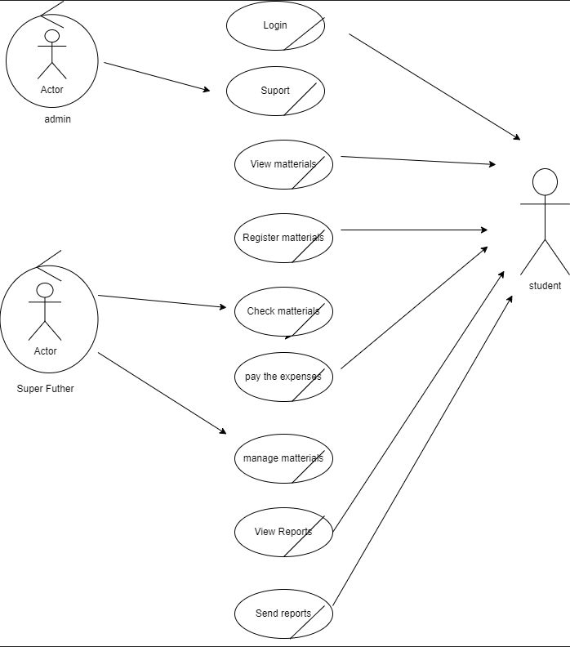
1- BUSINESS USE CASE DIAGRAM

Slide 21
1- BUSINESS USE CASE DIAGRAM
This diagram illustrates the interactions between various actors (users) and the system within a mobile registration materials application.
1- Admin: Can log in to the system. Can view and manage materials. Can check materials. Can view and send reports.
2- Student: Can register materials. Can check materials. Can pay expenses
3- Supervisor: Can register materials. Can manage materials. Can view and send reports.
- Login: Authenticates users and grants access to the system.
- View Materials: Displays available materials to users.
- Register Materials: Allows users to add new materials to the system.
- Check Materials: Enables users to verify the availability and details of materials.
- Pay Expenses: Facilitates payment for expenses related to materials.
- Manage Materials: Provides admins with the ability to modify and update materials.
- View Reports: Displays reports on material usage, expenses, and other relevant information.
- Send Reports: Allows users to generate and share reports.

Slide 22
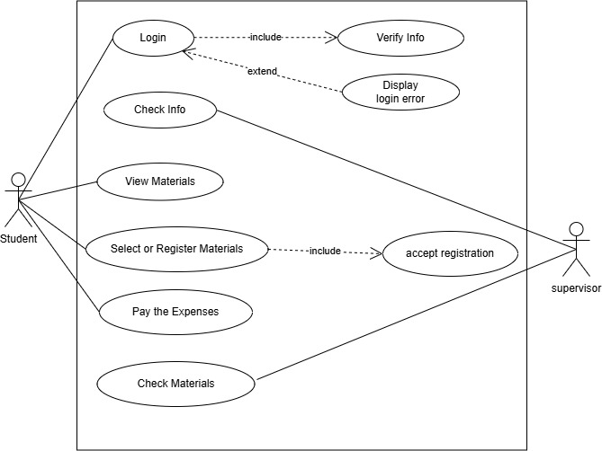
2- USE CASE DIAGRAM

Slide 23
2- USE CASE DIAGRAM
This use case diagram illustrates the various interactions involved in a student's registration process for materials on a mobile platform.
The diagram includes the following use cases:
1- Login: The student initiates the process by logging into the system.
2- Check Info: The student verifies their personal information.
3- View Materials: The student browses available materials for registration.
4- Select or Register Materials: The student chooses the materials they wish to register for.
5- Pay the Expenses: The student completes the payment process for the selected materials.
6- Check Materials: The student can review the status of their registered materials.

Slide 24
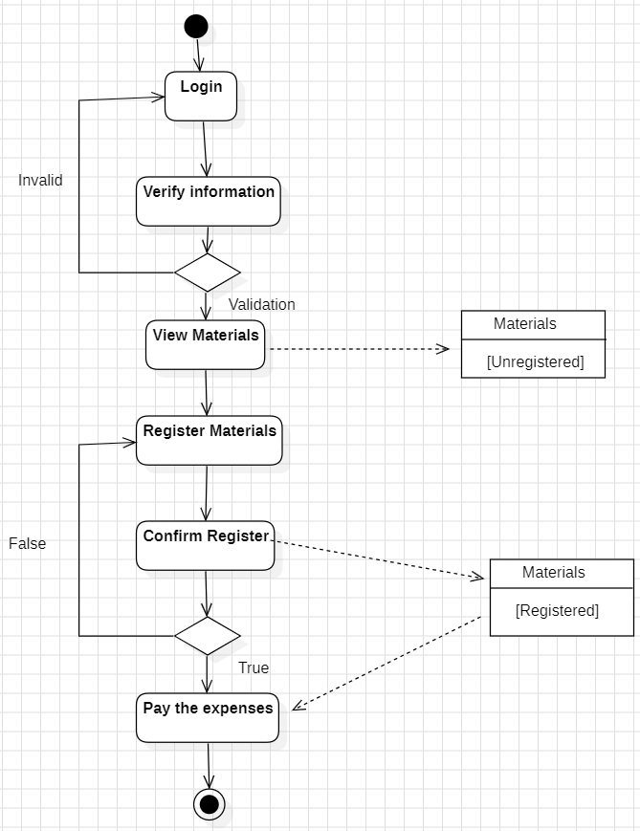
3- ACTIVITY DIAGRAM
(Student)

Slide 25
3- ACTIVITY DIAGRAM
This activity diagram models the registration and login process for accessing and managing materials.
1- Login: Users start by logging into the system.
2- Verify Information: If registering, the system verifies the provided information.
3- Validation: The system validates the user's credentials or registration details.
4- View Materials (Unregistered): If the user is not registered, they can view materials but cannot access or manage them.
5- Register Materials: If the user is registered, they can register materials.
6- Confirm Register: The system confirms the registration of materials.
7- Pay Expenses: If the registration is successful, the user may need to pay associated expenses.

Slide 26
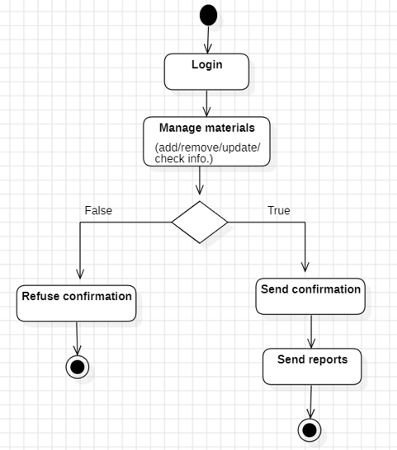
3- ACTIVITY DIAGRAM
(Supervisor)

Slide 27
3- ACTIVITY DIAGRAM
This activity diagram models a process for managing materials.
1- Login: The process starts with a user logging into the system.
2- Manage Materials: The logged-in user can perform various actions on materials, such as adding, removing, updating, or checking information about them.
3- Confirmation: After managing materials, a decision is made whether to send a confirmation or refuse it.
4- Send Reports: If confirmation is sent, the process moves on to sending reports.

Slide 28
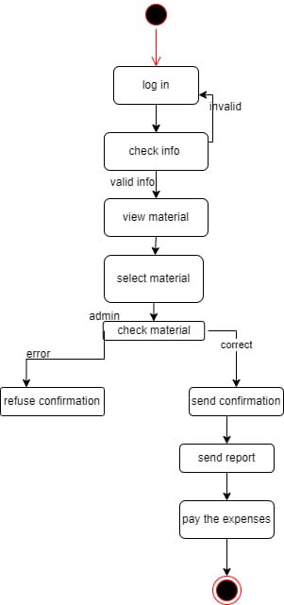
4- STATECHART DIAGRAM

Slide 29
4- STATECHART DIAGRAM
This diagram that outlines a sequence of steps for processing materials and expenses.
1- Log in: A user attempts to log in.
If invalid, the process halts.
If valid, the process continues to the next step.
2- Check info: User information is verified for validity.
If valid, the user can proceed to the next stage.
3- View material: The user views the material available for selection.
4- Select material: The user selects a material for further action.
5- Check material: The selected material undergoes an admin check:
If there is an error, the process leads to refuse confirmation.
If the material is correct, the process moves to send confirmation.
6- Send confirmation: Confirmation is sent for the correct material.
7- Send report: A report is generated and sent.
8- Pay the expenses: Final step where expenses are paid.

Slide 30
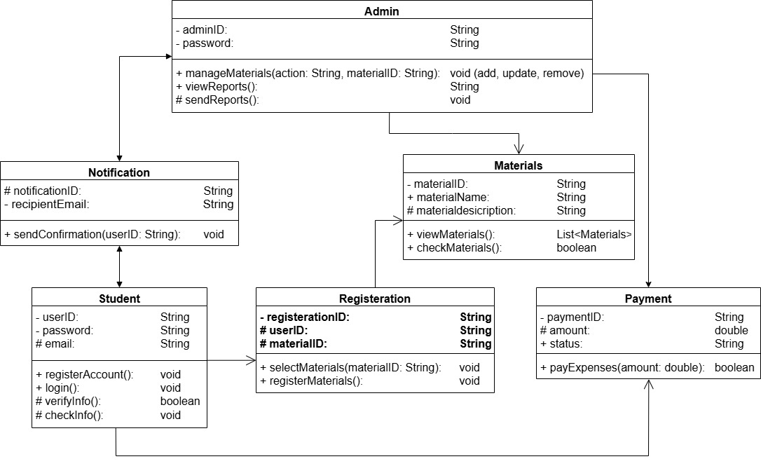
5- CLASS DIAGRAM

Slide 31
5- CLASS DIAGRAM
This class diagram models a system for managing materials and registrations.
It includes classes for Admin, Student, Notification, Materials, Registration, and Payment.
1- Admin: This class represents the administrator of the system. It has attributes for managing materials and sending notifications.
2- Student: This class represents a student user. It has attributes for user information, email, and payment details.
3- Notification: This class represents notifications sent to students. It has attributes for recipient email and content.
4- Materials: This class represents the materials that can be registered for. It has attributes for material ID, name, description, and availability.
5- Registration: This class represents a registration for a material. It has attributes for registration ID, student ID, material ID, and status.
6- Payment: This class represents a payment made for a registration. It has attributes for payment ID, registration ID, amount, and status.
Relationships:
. Admin - Materials: The Admin class has a relationship with the Materials class, indicating that the admin can manage materials (add, update, remove).
. Admin - Notification: The Admin class has a relationship with the Notification class, indicating that the admin can send notifications to students.
. Student - Registration: The Student class has a relationship with the Registration class, indicating that a student can register for materials.
. Student - Payment: The Student class has a relationship with the Payment class, indicating that a student can make payments for registrations.
. Registration - Materials: The Registration class has a relationship with the Materials class, indicating that a registration is associated with a specific material.
. Registration - Payment: The Registration class has a relationship with the Payment class, indicating that a registration can have associated payments.

Slide 32
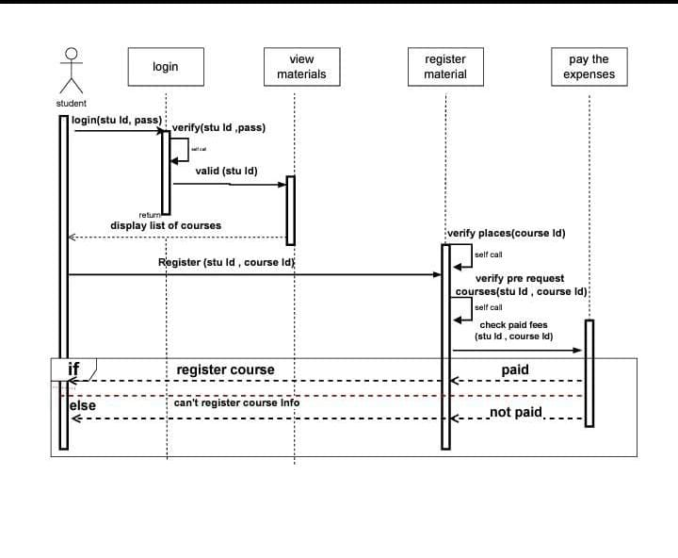
6- SEQUENCE DIAGRAM

Slide 33
6- SEQUENCE DIAGRAM
This is a sequence diagram representing the process of course registration for a student. It illustrates the following steps:
1- Login: The student logs in using their student ID and password, which is verified.
2- View Materials: Once logged in, the system displays a list of available courses.
3- Register for a Course: The student selects a course to register for.
The system verifies: Availability of places in the course.
Whether the student meets any prerequisites. If the student has paid the required fees.
4- Decision: If all conditions are satisfied, the course is successfully registered.
Otherwise, the system informs the student that the course registration is unsuccessful.
The diagram also includes self-calls for validations (e.g., prerequisites and payment checks) and conditional logic to determine the outcome.

Slide 34
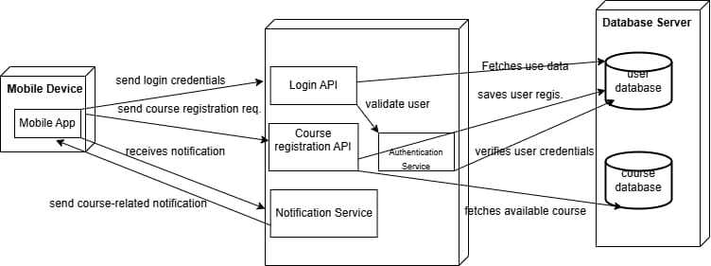
7-DEPLOYMENT DIAGRAM

Slide 35
7-DEPLOYMENT DIAGRAM
This deployment diagram illustrates the architecture of a mobile course registration system. The system consists of the following components:
1- Mobile Device: The user interacts with the system through a mobile device.
The device runs a mobile app that communicates with the backend server.
2- Mobile App: The mobile app handles user interactions and sends requests to the backend server.
It receives notifications from the server and displays them to the user.
3- Backend Server: The backend server hosts the core functionality of the system.
It includes the following components:
4- Login API: Handles user authentication and authorization.
Course Registration API: Processes course registration requests.
Notification Service: Sends notifications to users.
5- Database Server: The database server stores user data and course information.
It includes the following databases: User Database: Stores user credentials and personal information.
6- Course Database: Stores information about available courses.
7- Interactions: The mobile app sends login credentials and course registration requests to the backend server.
The backend server validates user credentials, fetches user data, and saves user registration information.
The backend server fetches available courses from the course database and sends notifications to users.
The notification service sends course-related notifications to the mobile app.

Slide 36
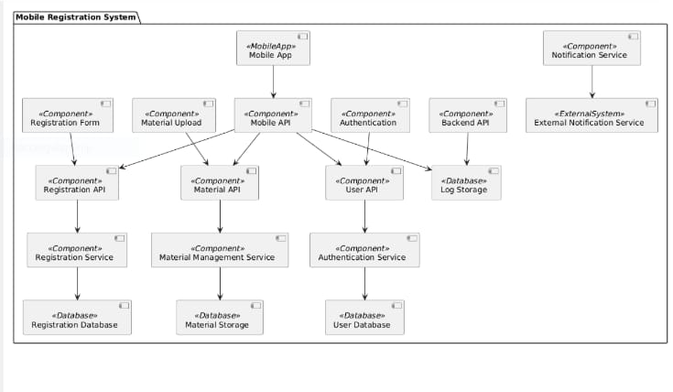
8-COMPONENT DIAGRAM

Slide 37
8-COMPONENT DIAGRAM
This component diagram represents the architecture of a Mobile Registration System for managing user registration and material uploads.
1- Mobile App: The main interface for user interaction.
2- Components:
. Registration Form and Material Upload: Handle user input for registration and uploading materials.
. Mobile API: Serves as the central component for communication between the app and backend services.
. APIs (Registration API, Material API, User API, Backend API): Facilitate specific functions, such as handling registration, material management, and user authentication.
. Services: Process registration, materials, and authentication (e.g., Registration Service, Material Management Service, and Authentication Service).
. Databases: Store data (Registration Database, Material Storage, and User Database) and logs for operations.
. Notification Services: Enable communication with an External Notification Service to notify users about their registration.

Slide 38
Thank you

